Slide 1

Visual Basic.NET Using Procedures

Slide 2
ROAD MAP
Introduction
Modular Coding
Subroutines
Functions
Arguments
Argument-Passing Mechanisms

Slide 3
INTRODUCTION
Application is made up of
Small, self-contained segments
Code is made up of
Small segments called Procedures
one procedure at a time
Two procedures:
Subroutines
functions

Slide 4
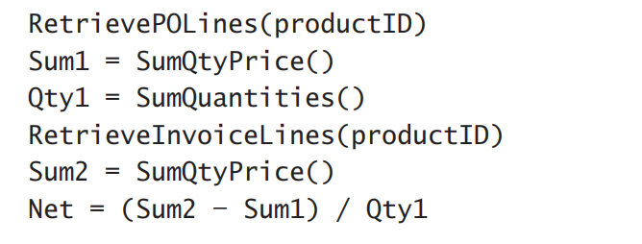
Modular Coding
Example:

Slide 5
Modular Coding
Divide-and-conquer approach
Broken down into simple tasks
Read almost like English
Programmers focus on different parts of application
Both functions and subroutines accept arguments (later in the section)

Slide 6
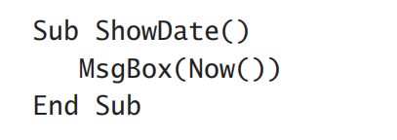
Subroutines
Subroutines
A block of segments that carries out a well-defined task
Sub… End Sub – invoke by a name
All variables are local within a subroutine
Do not return results
Example:

Slide 7
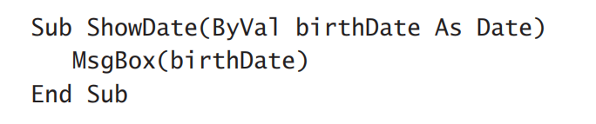
Subroutines
End Sub
control returns to the calling program
Exit Sub
Exist a subroutine prematurely
Arguments
Example:

Slide 8
Subroutines & Events Handlers
Event Handlers
a segment of code that is executed each time an external condition triggers the event
Perform all actions you want
Separate from rest of codes
Every Application is made up of event handlers
No need to return results
Implemented as subroutines

Slide 9
Functions
Functions
Returns results
Have types
All variables are local within a subroutines
Return value
The value you pass back to the calling program from a function
Value type = Function type (Must Match)
Accept arguments

Slide 10
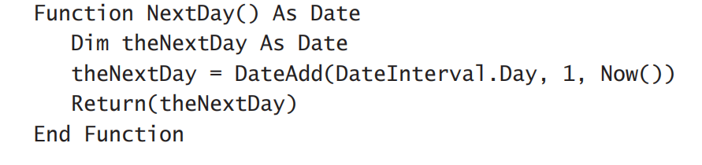
Functions
Functions… End Function
Example:
Custom function has unique name
Modify default scope of a function with keywords:
Public / Private / Protected / Friend / Protected Friend

Slide 11
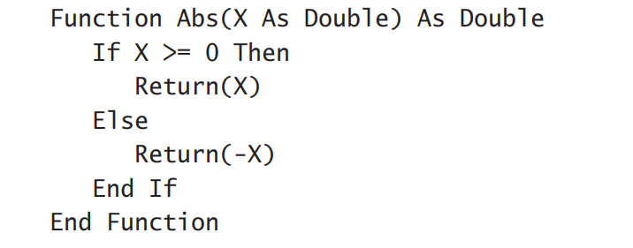
Build-ln Functions
.NET Framework provides a large number of functions
Abs() function
Example：

Slide 12
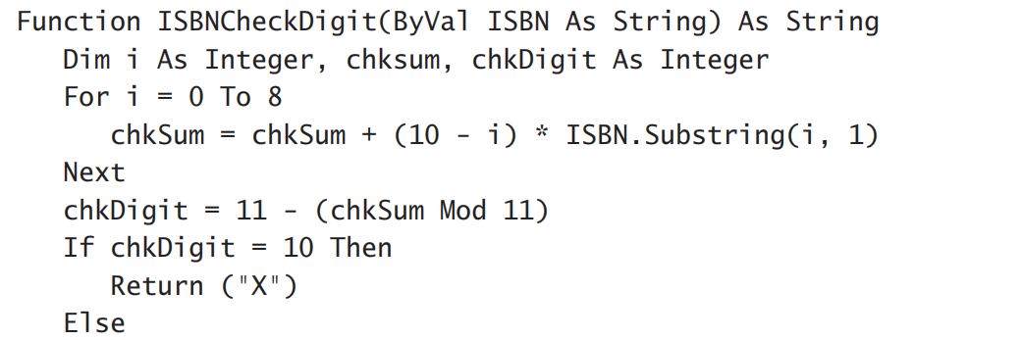
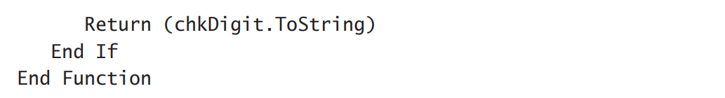
Custom Functions
called from several places in the application
ISBNCheckDigit() function
Example：

Slide 13
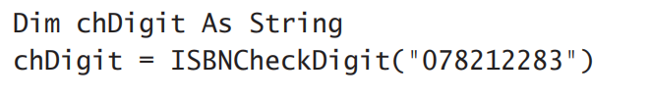

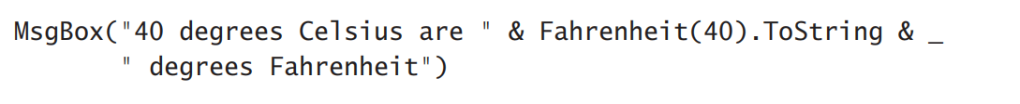
Calling Functions and Subroutines
To call a procedure: enter name followed by arguments
The values of the arguments must match their declared type
Functions are called by name, and a list of arguments follows the name in parentheses
Functions can be called from within expressions

Slide 14
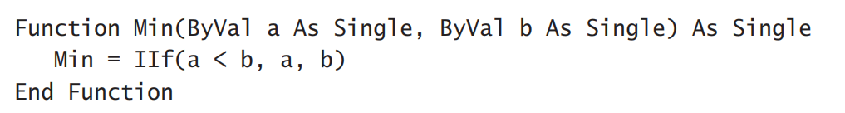
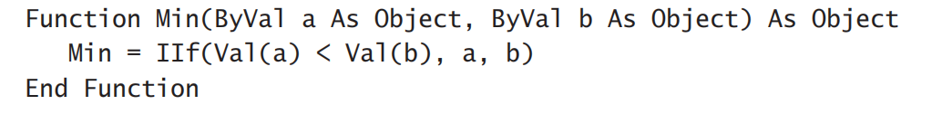
Arguments
Recall:
Arguments – a value you pass to the procedure and on which the procedure usually acts
Functions accept argument
- Min()
IIf()
built-in function that evaluates the first argument, which is a logical expression\
If expression = TRUE, it returns second argument; otherwise, it returns third argument
Min() function with the Strict option

Slide 15
Argument-passing Mechanisms
Passing Arguments by Value
Passing Arguments by Reference
Returning Multiple Values
Passing Objects as Arguments

Slide 16
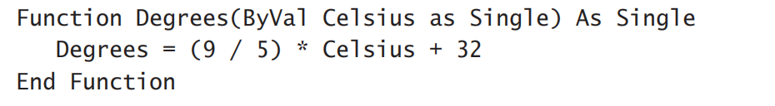
Argument-passing By Value
a copy of the argument
No permanent
Argument values are isolated from the procedure
Default: only the code segment can change values
ByVal keyword
Default: insert automatically if omit

Slide 17
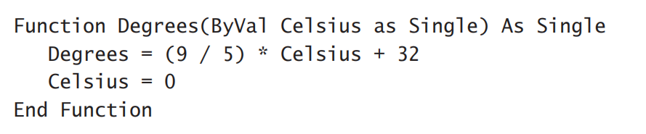
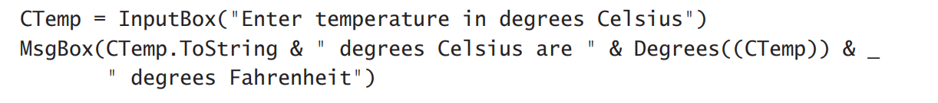
Argument-passing By Value
When change the value:
Result：

Slide 18
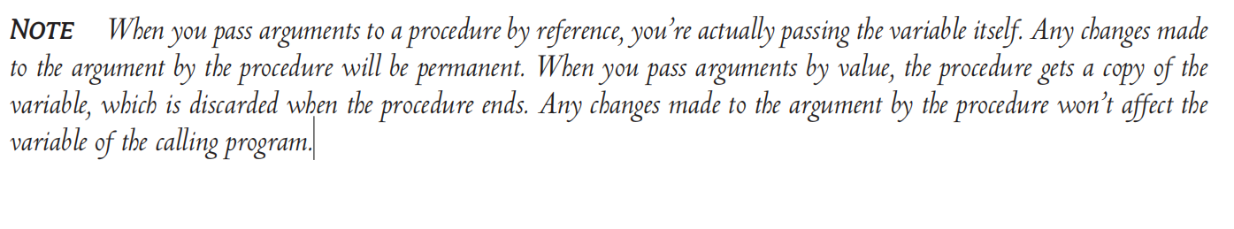
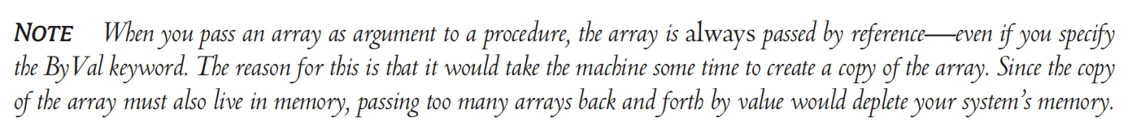
Argument-passing By Value
Note:

Slide 19
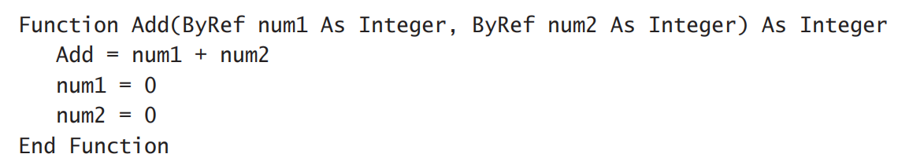
Argument-passing By Reference
Gives the procedure access to the actual variable
Change value permanently

Slide 20
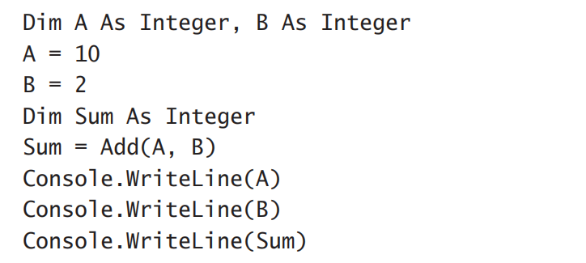
Argument-passing By Reference
Next…

Slide 21
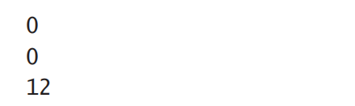
Argument-passing By Reference
Output window:
Changes remain in effect only in the function.

Slide 22
Returning Multiple Values
pass additional arguments by reference
& set their values from within the function’s code
Example:
Stats() function

Slide 23
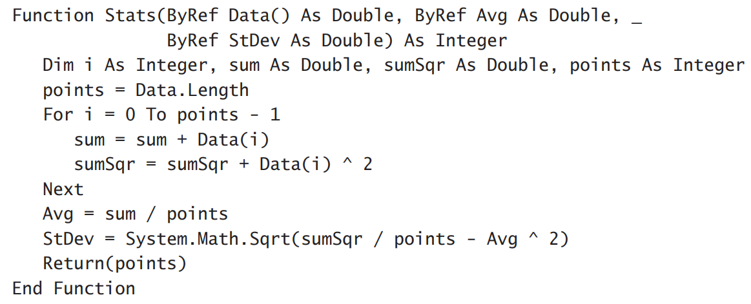
Returning Multiple Values
Stats() function: return Avg and StDev

Slide 24
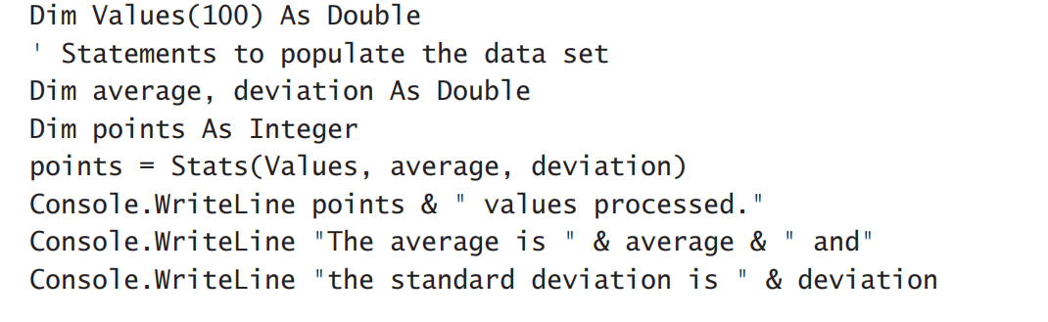
Returning Multiple Values
Call Stats() function:

Slide 25
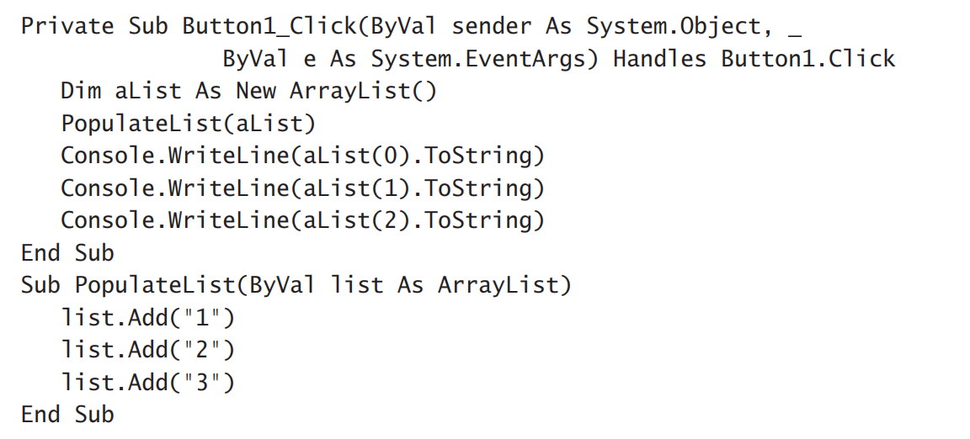
Passing Objects as Arguments
Passed by reference, even if you have specified the ByVal keyword

Slide 26
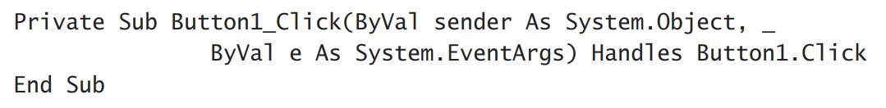
Event-Handler Arguments
Event-Handler:
Never return results
Implemented as subroutines
Accept two arguments:
Sender
e

Slide 27
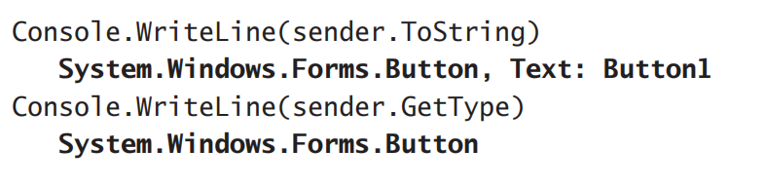
Event-Handler Arguments
Sender…
conveys information about the object that initiated the event
find out the type of the object that raised the event

Slide 28
Event-Handler Arguments
e…
An object that exposes some properties, which vary depending on the type of the event and the control that raised the event
The e argument passed to the Click event handler has no special properties.
Examine members of this argument:
The Mouse Event
Button
Clicks
Delta
X,Y
The Key Events
Alt, Control, Shift
KeyCode
KeyData
KeyValue

Slide 29
The Mouse Event
A series of events is triggered when click the mouse
A single click:
A MouseDown Event
A Click Event
A MouseUp Event

Slide 30
Button
Return the button that was pressed
MouseButtons enumeration:
Left, Middle, None, Right, XButton1, and XButton2
The e argument of the Click and DoubleClick events doesn’t provide a Button property
These two events can only be triggered with the left button.

Slide 31
Clicks
Return the number of times the mouse button was pressed and released
A single click:
1
Double-click:
2
You can’t click a control three times

Slide 32
Delta
Used with wheel mice
Read the number of detents (that is, notches or stops) that the mouse wheel was rotated

Slide 33
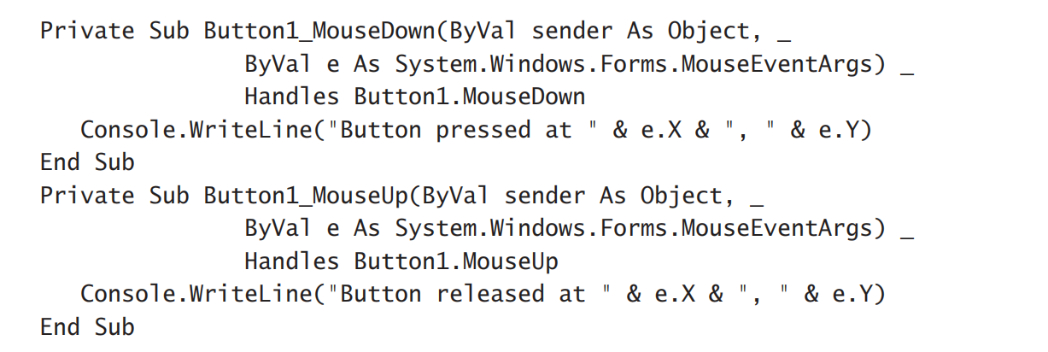
X,Y
Return the coordinates of the pointer at the moment the mouse button was pressed (in the MouseDown event) or released (in the MouseUp event)
If you click a Button control at the very first pixel (its top-left corner), the X and Y properties will be 0.
Example:

Slide 34

X,Y
If you press and release the mouse at a single point, both handlers will report the same point
If you move the pointer before releasing the button, you will see four values like the following

Slide 35
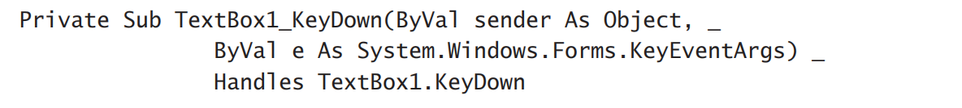
The Key Events
One of the most important events in programming the TextBox
Raised when a key is pressed, while the control has the focus
The KeyDown event handler’s definition:

Slide 36
Alt, Control, Shift
These three properties return a True/False value indicating whether one or more of the control keys were down when the key was pressed.

Slide 37
Key Code
Return the code of the key that was pressed
Its value in the keys enumeration
Keys enumeration:
A member of all keys: mouse keys
Each key has its own code
Usually corresponding to 2 different characters

Slide 38
Key Data
Return a value that identifies the key pressed
Distinguish the character or symbol on the key

Slide 39
Key Value
Return the keyboard value for the key that was pressed

Slide 40

Passing An Unknown Number of Arguments
When you Do NOT know how many arguments will be passed to the procedure…
Visual Basic supports the ParamArray keyword, which allows you to pass a variable number of arguments to a procedure
Example:
populate a ListBox control

Slide 41
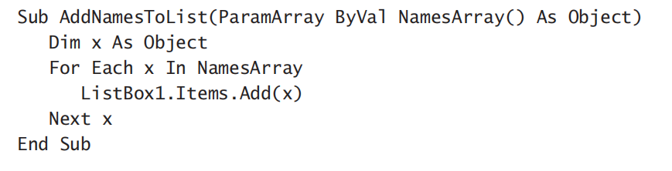

Passing An Unknown Number of Arguments
Adds a variable number of arguments
To add items to the list
To know the number of arguments

Slide 42
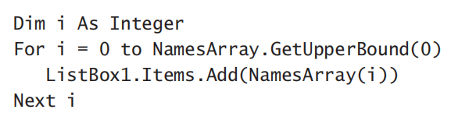
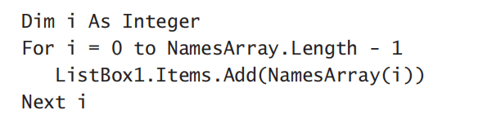

Passing An Unknown Number of Arguments
Go through all the elements of the NamesArray
To use the array’s Length property
To accept multiple arguments and omit some

Slide 43
Named Arguments
Main limitation is the order of arguments
By default: Visual Basic matches the values passed to a procedure to the declared arguments by their order
So far: positional arguments
Named Arguments:
supply arguments in any order
Recognized by name not order

Slide 44
Named Arguments
Example:

Slide 45
More Types of Function Return Values
Functions Returning Structures
Functions Returning Arrays

Slide 46
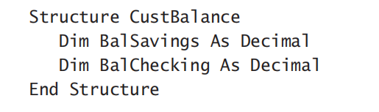
Functions Returning Values
create a custom data type (a structure) and write a function that returns a variable of this type
Example:

Slide 47

Functions Returning Arrays
Return arrays
write functions that return not only multiple values, but also an unknown number of values.
Example: Revise Stats() to return Arrays
1) Specify a type for the function’s return value, and add a pair of parentheses after the type’s name.
2) Declare an array of the same type and specify its dimension

Slide 48



Functions Returning Arrays
To return the Results array, simply use it as argument to the Return statement
In the calling procedure, you must declare an array of the same type without dimensions
Call the function and assign its return value to this array

Slide 49
Overloading Functions
Have multiple implementations of the same function, each with a different set of arguments and a different return value
Share the same name

Slide 50
Exercise
(1) What is the format of subroutines?
(2) Use build-in function Abs() to code:
If X>= 5, return X+5
If X<5, return X-5

